Slide 1
MAMBA Application

Slide 2
Background
MAMBA - Meta-Analysis Model-based Assessment of Replicability
Takes in summary statistics and applies a two-level mixture model
Provides a posterior probability of replicability (PPR) for SNP replicability
Mixture model focused on real zero/non-zero effect and spurious/non-spurious association
Purported benefits:
If fixed-effect assumptions hold, MAMBA becomes similar to inverse variance weighted meta-analysis
Uses information from other SNPs, genome-wide pooling

Slide 3
GSCAN
Question: How did MAMBA perform in determining replicability of real data compared to other methods?
GWAS and Sequencing Consortium of Alcohol and Nicotine (GSCAN)
Looked at Drinks per Week (DrnkWk), Smoking Initiation (SmkInit), Smoking Cessation (SmkCes), and Cigarettes Per Day (CigDay) phenotypes
Treated 23andMe dataset as replication dataset, and other GSCAN datasets as discovery datasets
“To compare different methods we used Kendall’s-tau27 to assess the concordance between p-values in discovery and replication phase.”
Replicable studies should have high p-values in replication and discovery cohorts
Nonreplicable studies with spurious signals would have lower p-values in replication cohort

Slide 4
Results Excerpt
“The p-values from both MAMBA and MAMBA-est had higher levels of concordance with the replication cohort p-value for every phenotype compared to alternative methods (Table 2). In addition, a visual comparison makes it clear that, compared to FE meta-analysis, the MAMBA method tends to produce less significant p-values for SNPs with low ranks in the replication dataset (which are more likely to be spurious associations), but similar results for the higher-ranking SNPs (which are more likely to have true non-zero effects) (Fig. 4a). This demonstrates improved power and robustness for MAMBA. In contrast, the RE method can be underpowered, as many SNPs which are ranked highly in the replication cohort do not have significant p-values in the discovery cohort, which makes Kendall’s tau correlation coefficient lower (Fig. 4b). On the other hand, BE and RE2 methods tend to produce p-values similar to FE regardless of the replication rank of the SNP (Fig. 4c, d), suggesting that they may be sensitive to outliers and detect spurious associations as significant. Compared to MAMBA, MAMBA-est had a slight decrease in the concordance, as more noise was introduced as numerous correlated SNPs were fitted (Table 2).”

Slide 5
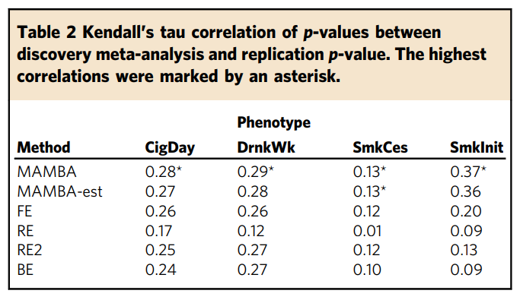
MAMBA = Meta-Analysis Model-based Assessment of replicability
MAMBA-est = MAMBA w/ correlated SNPs
FE = fixed effects inverse variance weighted meta-analysis
RE = random effects DerSimonian-Laird modes
RE2 = Han and Eskin’s random effects model that assumes no heterogeneity across studies under the null hypothesis
BE = Binary effects model that assumes for each SNP, a portion of the studies in the meta-analysis have null effects while the rest of the studies have fixed effects

